Slide 1
ThreadScan: Automatic and Scalable Memory Reclamation Authors: Dan Alistarh, William M. Leiserson, Alexander Matveev, Nir Shavit Presenter: Heena Dave (KSU ID: 810917421)

Slide 2
Concurrent Memory Reclamation
1

Slide 3
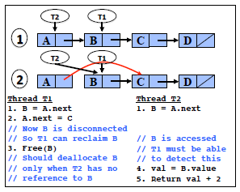
To devise techniques that allows a deallocating thread to verify that no other thread has a reference to that block.
Programmer makes the block unreachable and then use free() function.

Slide 4
Known techniques:
1) Reference Counting: Assign shared counters to objects and use them to count number of references to an object. Expensive as shared memory read-modify-write for each read. Less scalable.
2) Pointer based: Require programmer to explicitly declare currently accessed locations. Requires significant programming experience.
3) Epoch based: Reclaiming thread waits a sufficiently long period of time until it can be ensured that no registered thread holds a reference.

Slide 5
A new approach
2

Slide 6
Instead of manually tracking, using operating system signaling and thread control to automatically detect which memory locations are being accessed.
ThreadScan works as a memory reclamation library.
When a thread deletes a node, it adds it to shared delete buffer.
When the buffer becomes full, thread inserting the last node initiates a Collect procedure.
Collect procedure examines memory for references to nodes and frees nodes that are no longer referenced.
Key challenge in ThreadScan is implementation of efficient Collect.

Slide 7
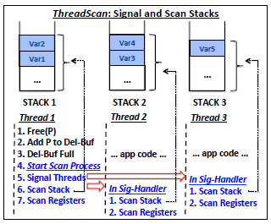

Slide 8
Advantages:
Errors in data structure code (eg. Infinite loops) will not prevent code from progressing. It offers strong progress as long as operating system does not starve threads.
Assumptions:
Nodes in delete buffer is correctly unlinked from data structure.
Pointers to live objects should be visible to the scan.

Slide 9
Node states and definition of concurrent memory reclamation
3

Slide 10
A node is a set of memory locations that can be in one of following states:
Allocated
Reachable
Removed
Retired
Free
Definition:
Concurrent memory reclamation is a problem in which a node (a set of nodes) which are removed and we are asked to move them to retired then to state free.

Slide 11
ThreadScan Algorithm
4

Slide 12
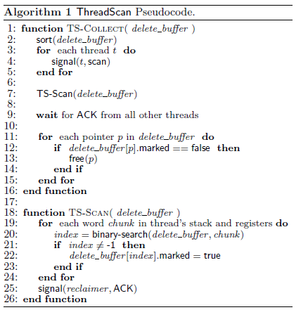

Slide 13
Signaling in inter-thread communication is done by POSIX Signals. When thread receives a signal then OS interrupts that thread and starts running signal handler.
In general, a thread is stalled (due to any reason), OS resumes the thread and invokes signal handler.
The only way to introduce delays into ThreadScan is by delaying OS signals. In modern OS, scheduler has a fair execution policy so that threads do not starve and so ThreadScan has a non-blocking progress guarantee.

Slide 14
Experimental Results
5

Slide 15
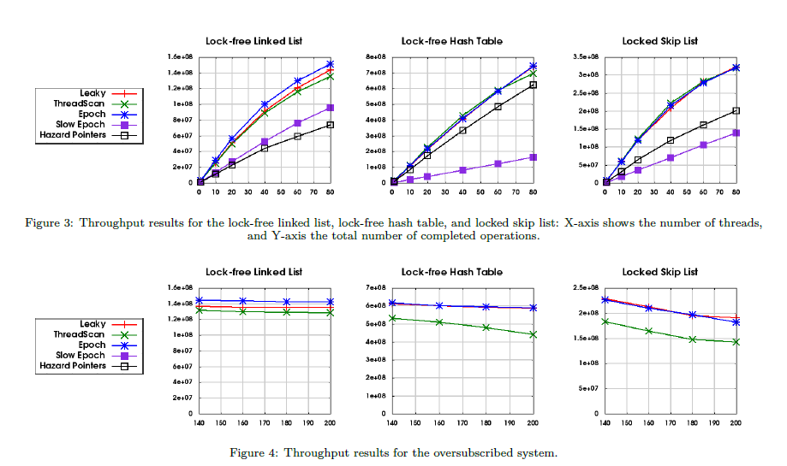

Slide 16
Future Work
6

Slide 17
The main usability limitation is in responsiveness of reclaimer.
The reclaiming thread must wait for acknowledgement of all other threads and then perform free calls. The number of these calls scale linearly with number of threads in the system.
Future work is to share reclamation overhead.

